Slide 1
Peer-graded Assignment: R Markdown Presentation & Plotly
By Joel Seah
Date:13/6/2023

Slide 2
Purpose
To find out if mpg is affected by hp

Slide 3
Loading the required libraries and packages
data(mtcars)
install.packages("ggplot2")
library(ggplot2)
install.packages("plotly")
library(plotly)

Slide 4
Plotting the Graph
cars <- plot_ly(data = mtcars, x = ~ hp, y = ~mpg, color = ~ am.label)

Slide 5
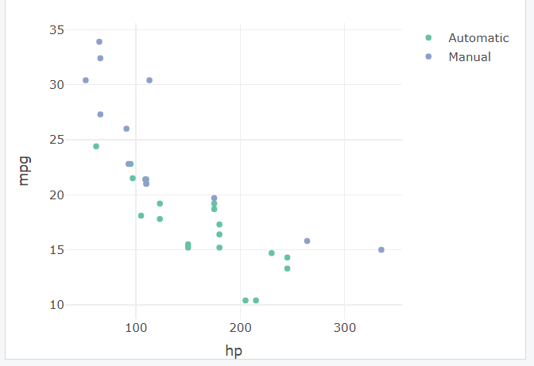
Output

